Slide 1

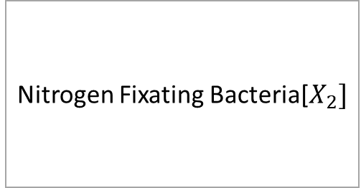

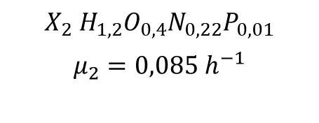



$$N_{2}$$
$${CH}_{2}O$$
$$O_{2}$$
Nitrogen Fixating Bacteria[$X_{2}]$
$$X_{2}{ H}_{1,2}O_{0,4}N_{0,22}P_{0,01}$$
$$μ_{2}={0,085 h}^{−1}$$
$${{NH}_{4}}^{+}$$
$${CO}_{2}$$

Slide 2


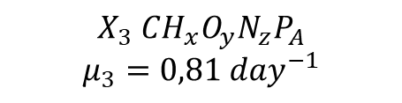
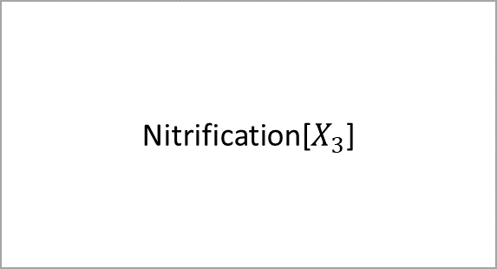



$${CO}_{2}$$
$$O_{2}$$
$${{NH}_{4}}^{+}$$
Nitrification[$X_{3}$]
$$X_{3} CH_{x}O_{y}N_{z}P_{A}$$
$$μ_{3}=0,81 {day}^{−1}$$
$${{NO}_{3}}^{−}$$
$$H_{2}0$$

Slide 3






$${CO}_{2}$$
$$O_{2}$$
$${{NH}_{4}}^{+}$$
dENitrifying
$$X_{4} CH_{x}O_{y}N_{z}P_{A}$$
$${{NO}_{3}}^{−}$$
$$H_{2}0$$

Slide 4




$X_{1} X_{2} X_{3}$ ${ X}_{4}$ $X_{5}$
$$O_{2}$$
deCOMPOSER
$$X_{6 }CH_{x}O_{y}N_{z}P_{A}$$
$${NH}_{3}$$

Slide 5



Reduction by aerobic bacteria
$$N_{2}$$
Nitrogen fixation
X2
Denitrification X4
$${{NO}_{3} }^{−}$$
$${{NH}_{4} }^{+}$$
Nitrification X3

